Slide 1
Fairness of LLMs in Allocating Chores
Siyona Behera, Pranav Ramesh, Dylan Van Berkel, David Badalamenti, Ayanna Norfleet
Project 1

Slide 2
Motivation & Research Context
Why chores?
  Most fairness studies assume positive goods → people want them
  Chores are negative goods → people avoid them
  Creates new tensions in fairness: EF may conflict with PO
  Inspired by Hosseini & Khanna (2025)
Research questions
  How do LLMs behave when asked to divide undesirable tasks?
  Do they naturally produce fair or efficient allocations?
  How sensitive are results to prompt phrasing?

Slide 3
Project Pipeline Overview
Create chore allocation instances→
Design prompts (Generate & Select) →
Query LLMs (GPT-4o + Claude 3.5S) →
Parse messy LLM outputs into structured allocations →
Evaluate fairness & efficiency criteria
↓
(Final milestone) Aggregate statistics and visualize trends

Slide 4
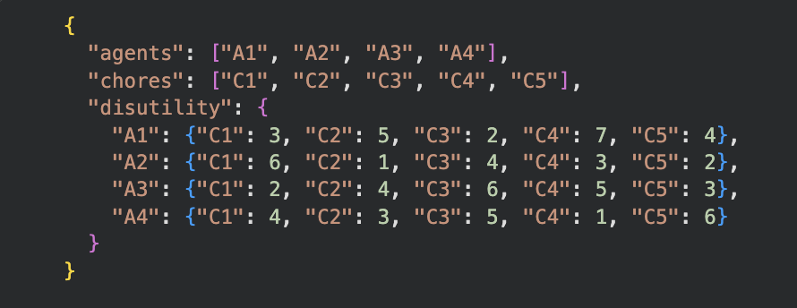
Milestone 1 Recap (Instance Generation)
Dataset:
18 instances (3–5 agents × 3–6 chores)
Each with additive disutilities or costs
Fairness notions selected:
EF, EF1, EQ, RMM
  Efficiency notions:
    PO, SO
Prompts created:
  Generate-mode
  Select-mode
  Disutility vs cost phrasing

Slide 5
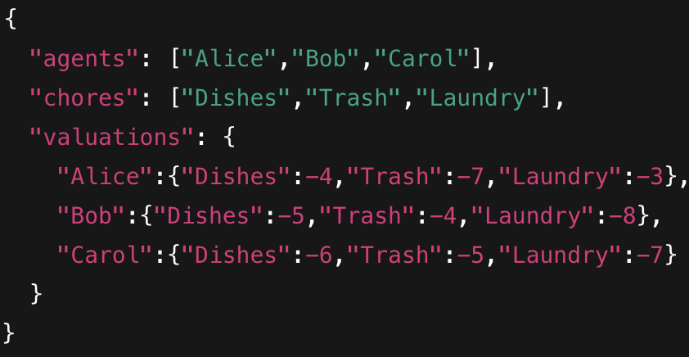
Instance Creation Examples (Example 1)
Spread out bad chores differently
Create conflicts: Trash is bad for all → EF becomes tricky
Forces LLM to choose between balance vs efficiency

Slide 6
Instance Creation Examples (Example 2)
Example Instance: 5 Agents × 4 Chores
One agent has extremely high cost for one task
Two agents have similar costs → interesting EQ dynamics
Some chores universally bad (disutility > −8)

Slide 7
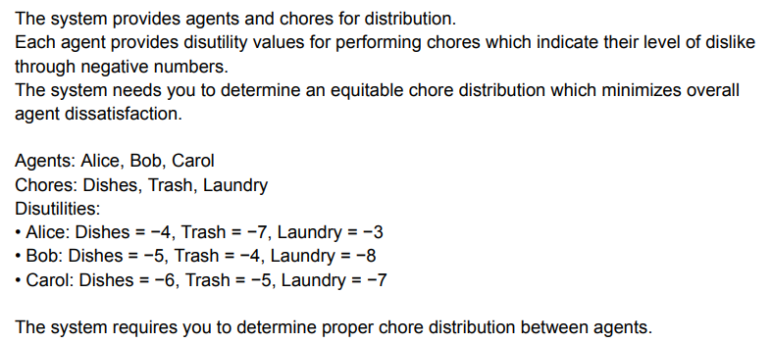
Fairness & Efficiency Concepts We Focus On
Fairness Criteria
  EF – No one prefers another’s bundle
  EF1 – EF up to removing one item
  EQ – Equal total disutility
  RMM – Rawlsian maximin (maximize minimum utility)
Efficiency Criteria
  PO – No agent can be made better without harming another
  SO – Minimize total disutility (global efficiency)

Slide 8
Worked Example: Envy-Freeness (EF)
Example Instance: 5 Agents × 4 Chores
One agent has extremely high cost for one task
Two agents have similar costs → interesting EQ dynamics
Some chores universally bad (disutility > −8)

Slide 9
Worked Example: PO / SO
Example Instance: 5 Agents × 4 Chores
One agent has extremely high cost for one task
Two agents have similar costs → interesting EQ dynamics
Some chores universally bad (disutility > −8)

Slide 10
Milestone 2 Goals
Primary objectives:
  Build working API pipeline
  Test pipeline with at least two LLMs
  Parse and extract allocations
  Compute fairness/efficiency of outputs
Deliverable:
  A successful end-to-end query + fairness evaluation.

Slide 11
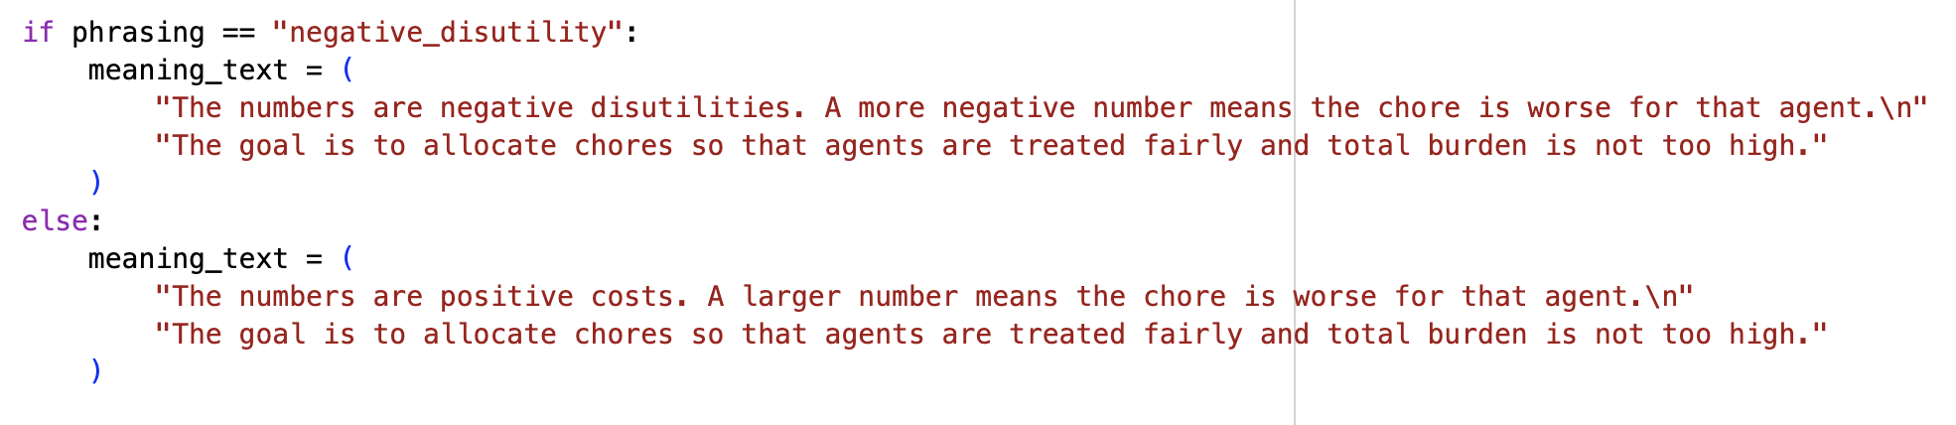
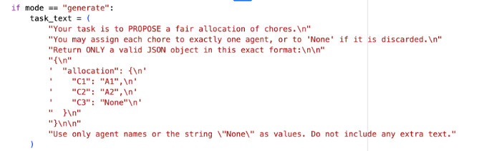
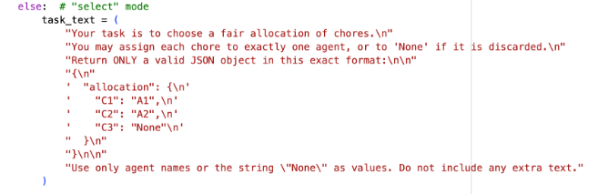
Prompt Engineering
Two prompt modes:
  Generate: LLM invents an allocation
  Select: LLM chooses from 3 candidates
Two phrasings:
  Negative disutilities (“−7 means worse”)
  Positive costs (“Cost 7 means worse”)
Why both matter:
  Models often behave differently depending on negativity framing.

Slide 12
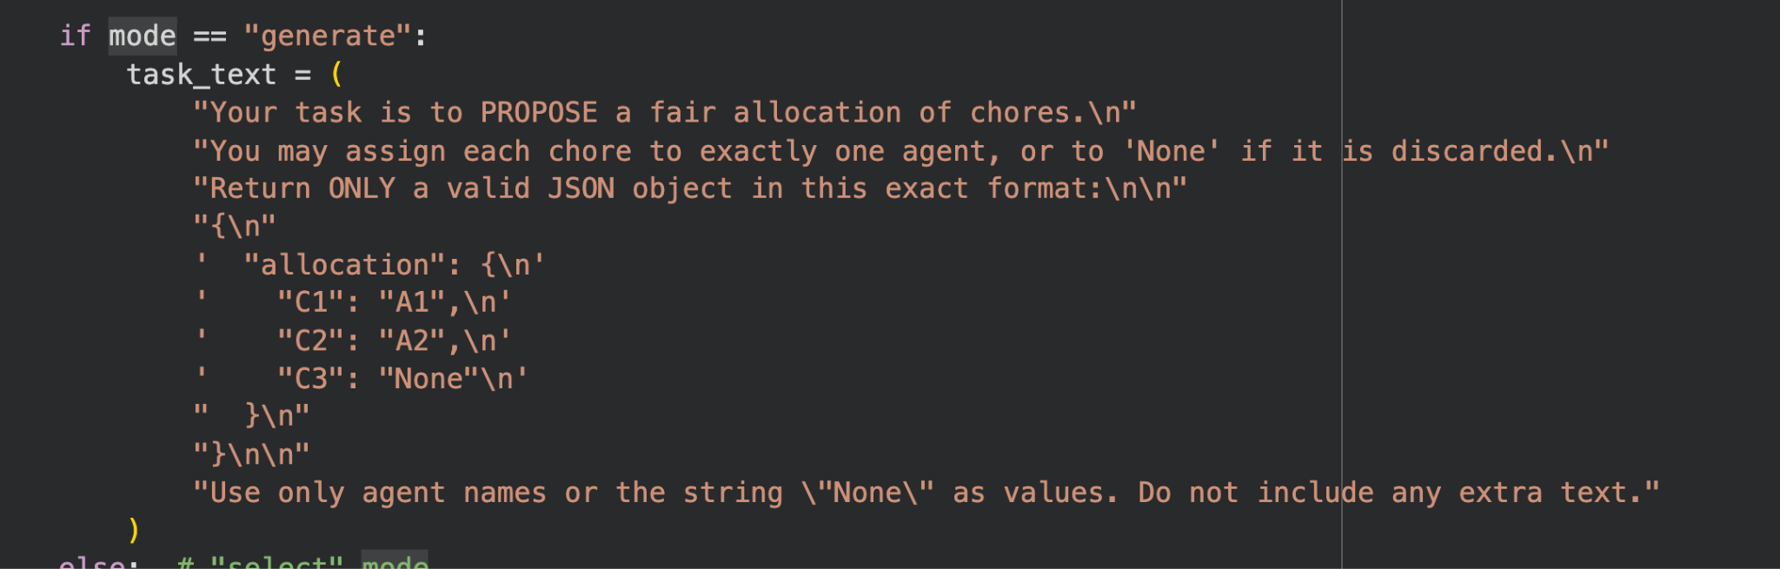
Example Prompt (Generate-Mode)
Show actual prompt text from your Colab:

Slide 13
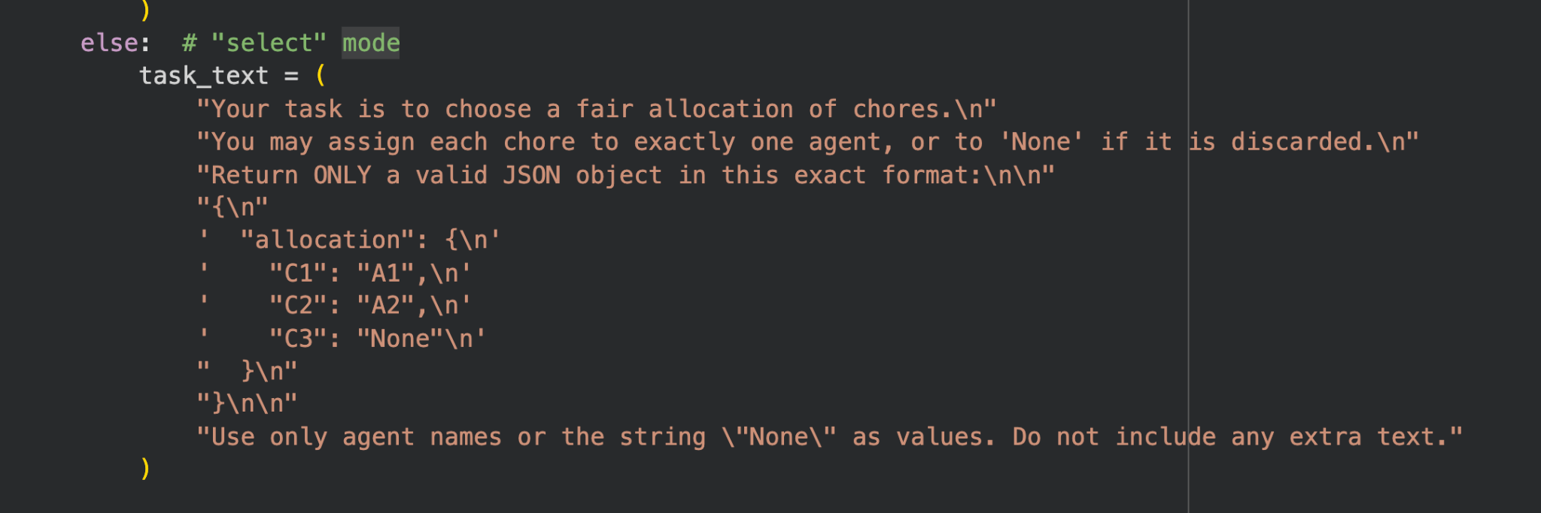
Example Prompt (Select-Mode)
Show prompt with 3 candidate allocations.

Slide 14
LLM Configuration
Models tested:
  GPT-4o (OpenAI)
  Claude 3.5 Sonnet (Anthropic)
Settings:
  Temperature = 1.0
  ~10 test runs per model for 5 instances
  JSON-safe format preferred

Slide 15
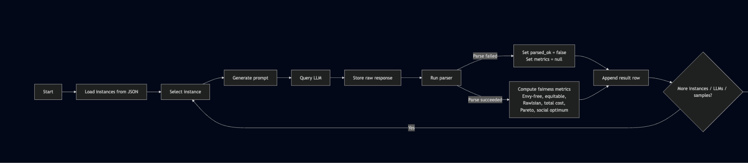
API Pipeline Flow
Notes:
pranav

Slide 16
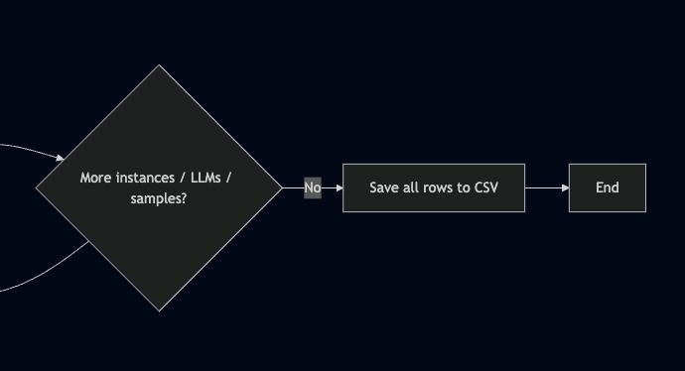
API Pipeline Flow Continued
Notes:
pranav

Slide 17
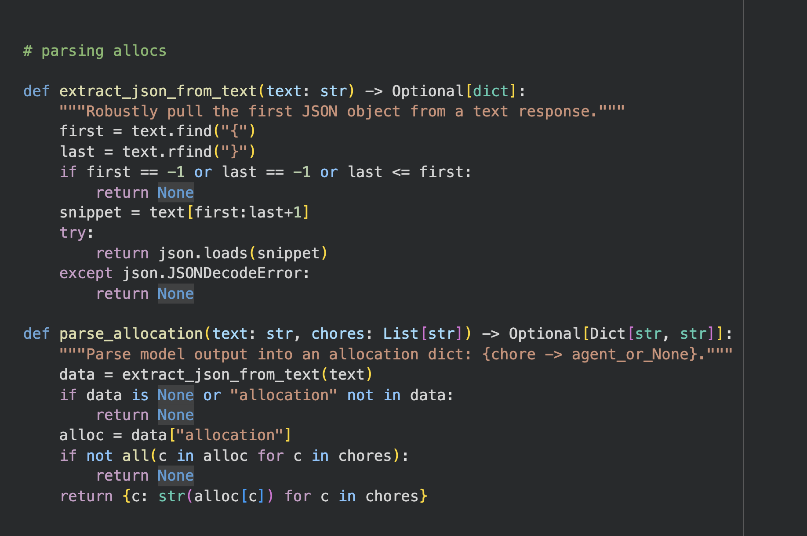
Parsing Challenges
LLMs returned formats like:
JSON
Chore → Agent lines
Agent: [Chore list]
Markdown tables
Entire explanations + multiple allocations
Solution: Two layered parsing script.
Grab “the first JSON object” out of any messy text. If we get something invalid it's ignored.
Enforce the expected allocation shape.
Notes:
pranav

Slide 18
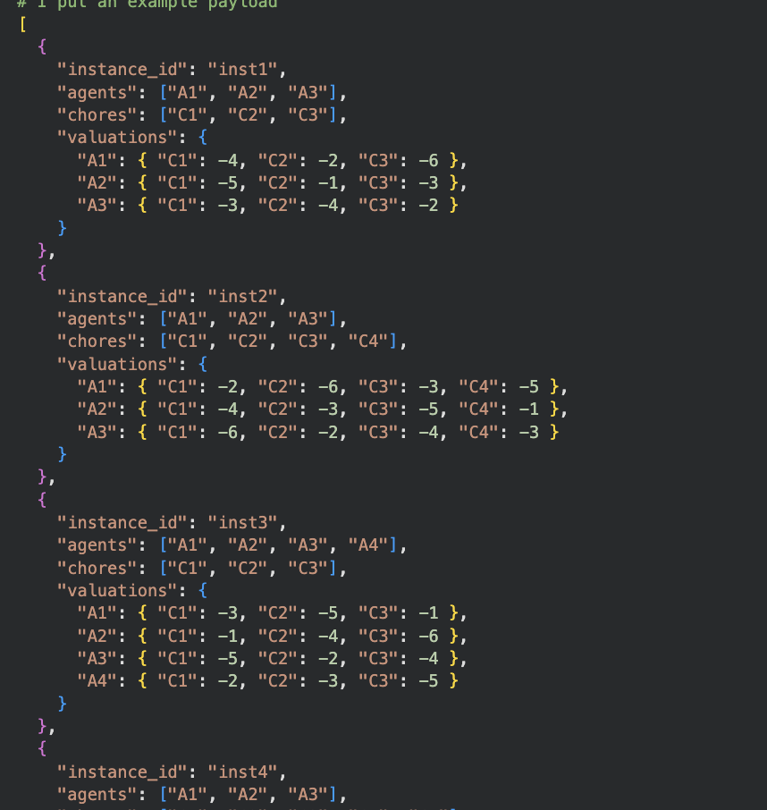
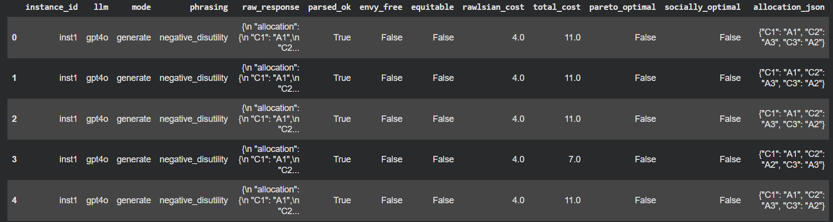
End-to-End Example
Show:
Instance
Prompt
Raw LLM Response
Parser Output (JSON)
Fairness results table
Notes:
pranav

Slide 19
Early Observations from 10 Trial Runs
Interesting early patterns:
  GPT-4o tries to balance total cost (SO-heavy)
  Claude prefers symmetry (EQ-focused)
  PO is satisfied more often than EF
  Disutility phrasing causes more cautious allocations
  Cost phrasing causes models to minimize extremes

Slide 20
Lessons Learned
Prompt phrasing strongly influences fairness results
Parsing is much harder than expected — LLMs produce messy outputs
Some fairness notions are naturally harder for LLMs (EF rarely holds)

